Slide 1

04/28/2020 | CIS 627 161 BIG DATA ANALYTICS CAPTSTONE | Max Franke
Classification of news headlines with impact on the probability of stock prices changes

Slide 2
Agenda
1
Problem and results summary
2
Data and tidying
3
Models and parameters
4
Technical analysis and findings

Slide 3

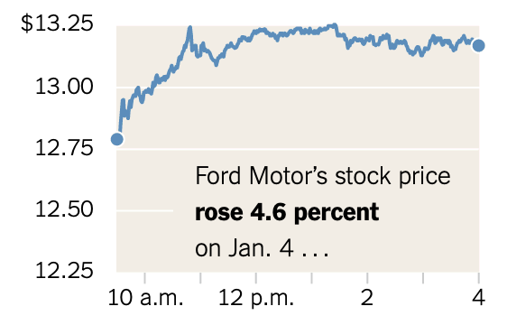
1
Problem and results summary
Input Layer
Current stock price
Current Volume
HEADLINE WITH PUBDATE
Avg. Price Difference for Tag 1
Avg. Price Difference for Tag 1
Avg. Price Difference for Tag 1
Picture Source: https://www.nytimes.com/2017/02/16/business/dealbook/trump-tweets-stock-market-trading-bots.html?_r=0

Slide 4
2
Data and tidying

Slide 5
3
Models and parameters

Slide 6
4
Technical analysis and findings

Slide 7

Thank you
Max Franke

Slide 8







Literature – eCommerce Performance
Performance Marketing [I. Kamps, D. Schetter], 2018
Case Study: Social Data-Analyse [Bonduelle, talkwalker], 2018
Whitepaper: KPIs im E-Commerce [dotsource], 2018
Kennzahlenmodell zur Erfolgsbewertung des E-Commerce [C. Hienerth], 2007
Trend Studie 2018 [Trakken], 2018
Whitepaper: Search-Engine Advertising optimieren [dotsource], 2016
Google Analytics und Co [H. Haller, M. Hartwig], 2010

